Slide 1
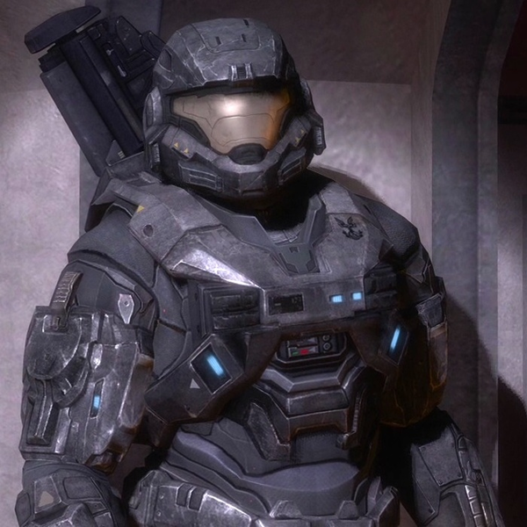
Notes:
Spartan-B312 (Noble 6)

Slide 2
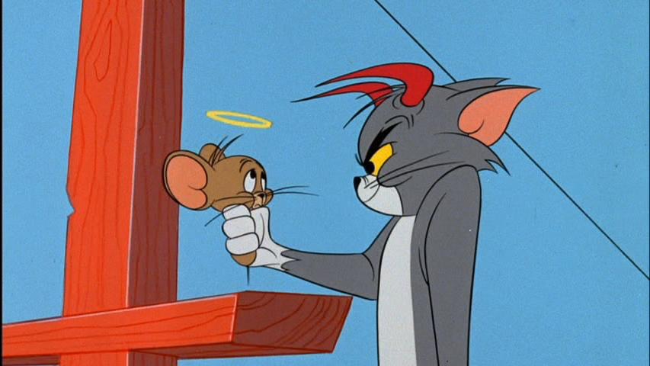
Notes:
Tom and Jerry (or just Jerry)

Slide 3
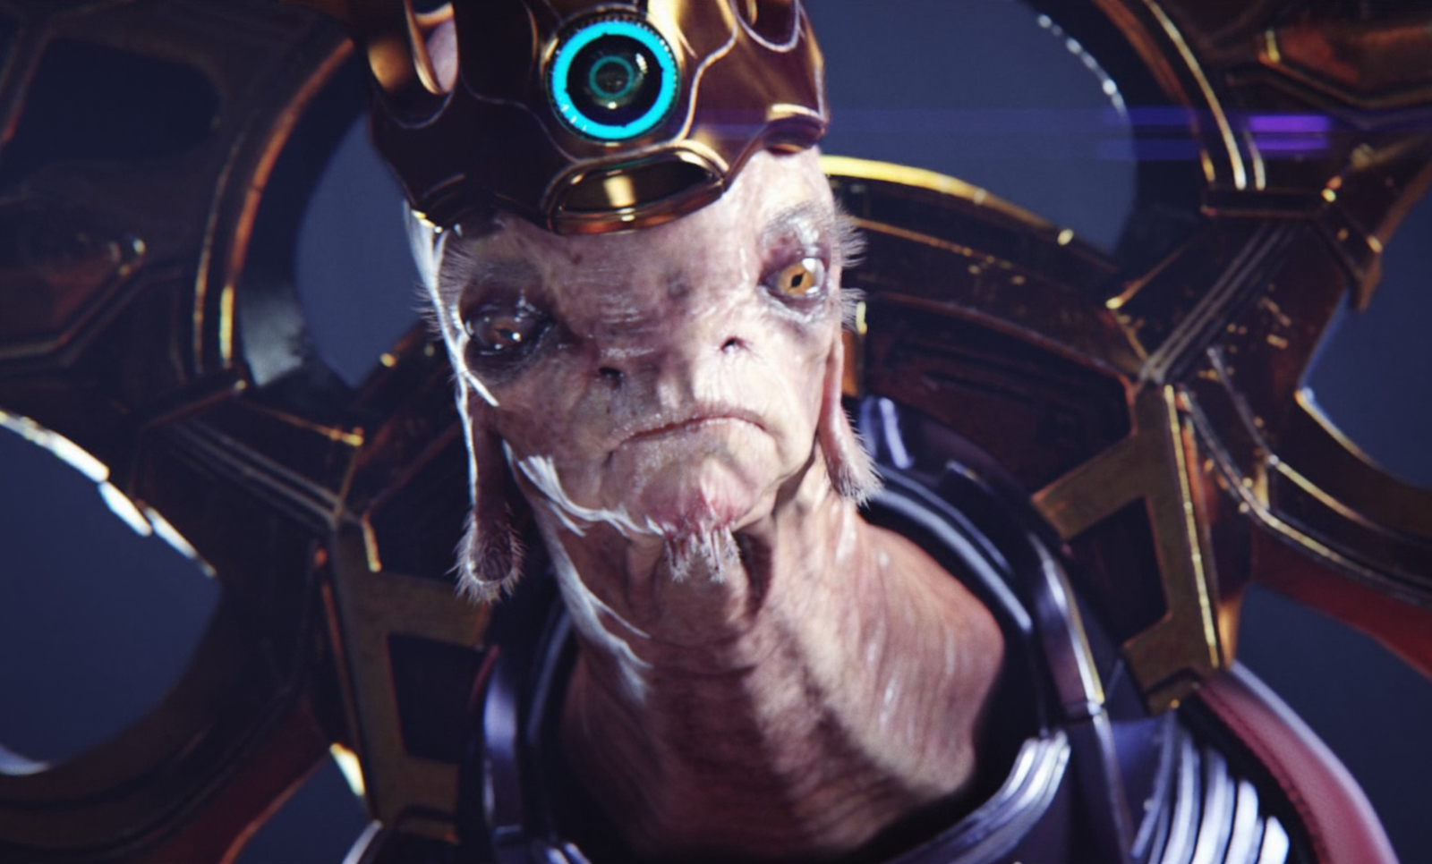
Notes:
(High prophet of) Truth

Slide 4
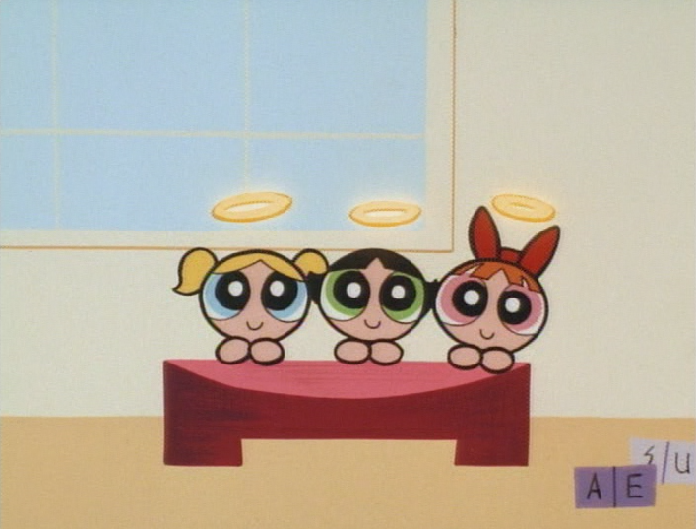
Notes:
Powerpuff girls

Slide 5
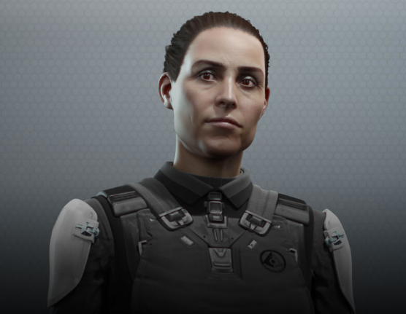
Notes:
Serin Osman

Slide 6
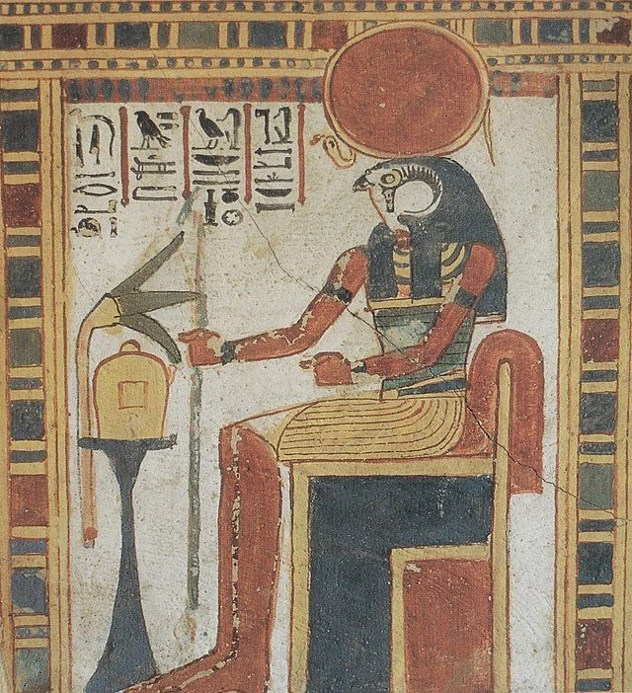
Notes:
Ra

Slide 7
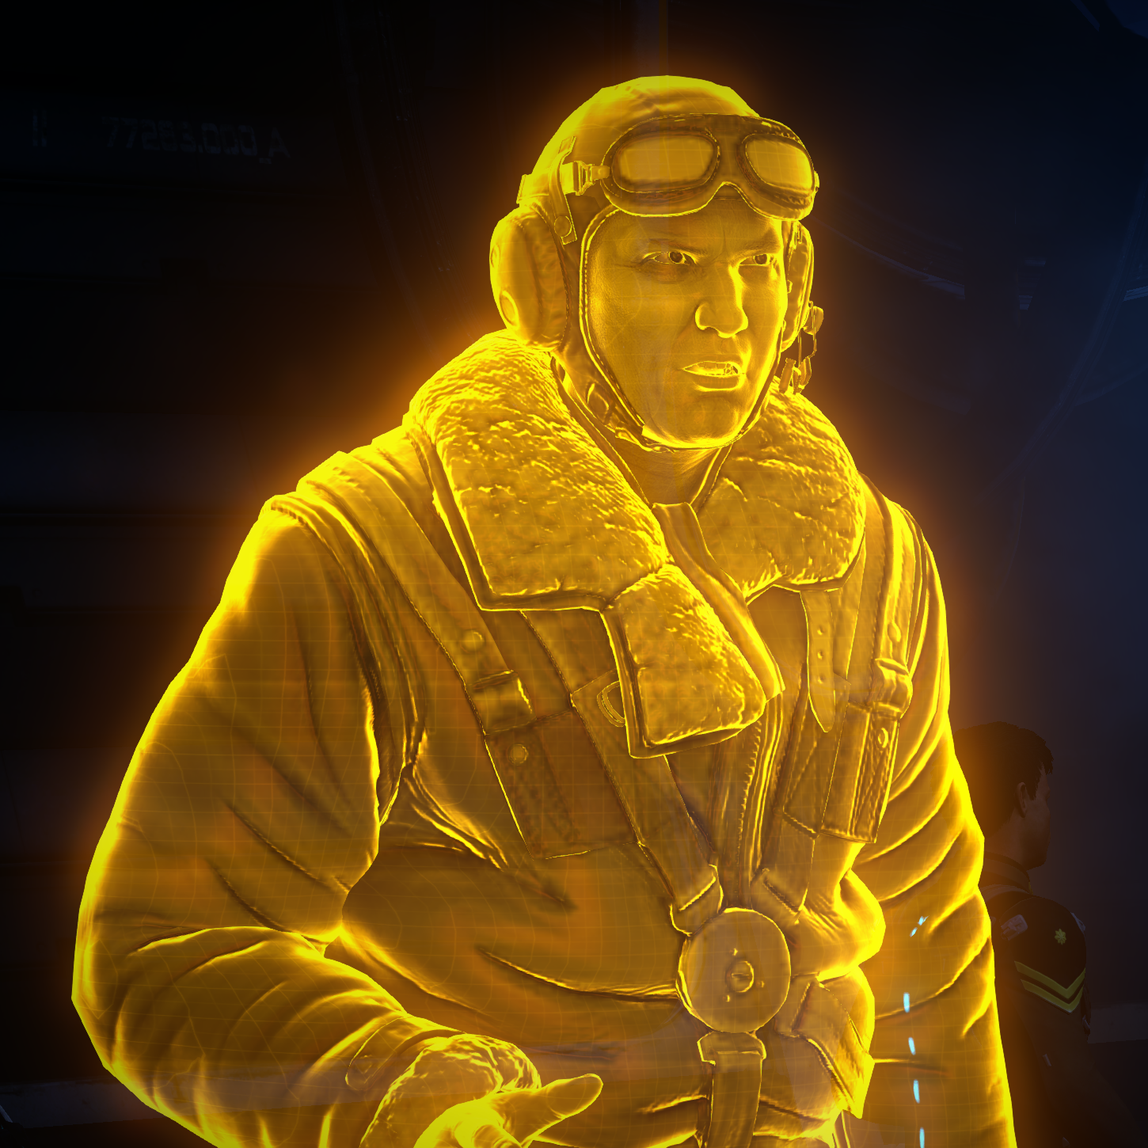
Notes:
Roland

Slide 8
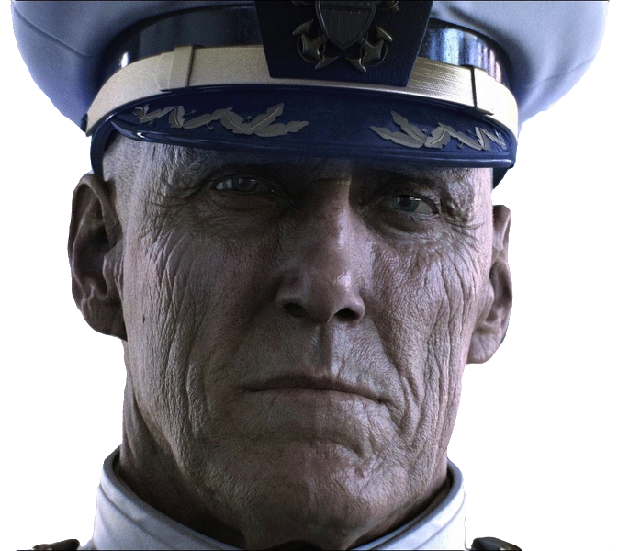
Notes:
Terrence Hood

Slide 9
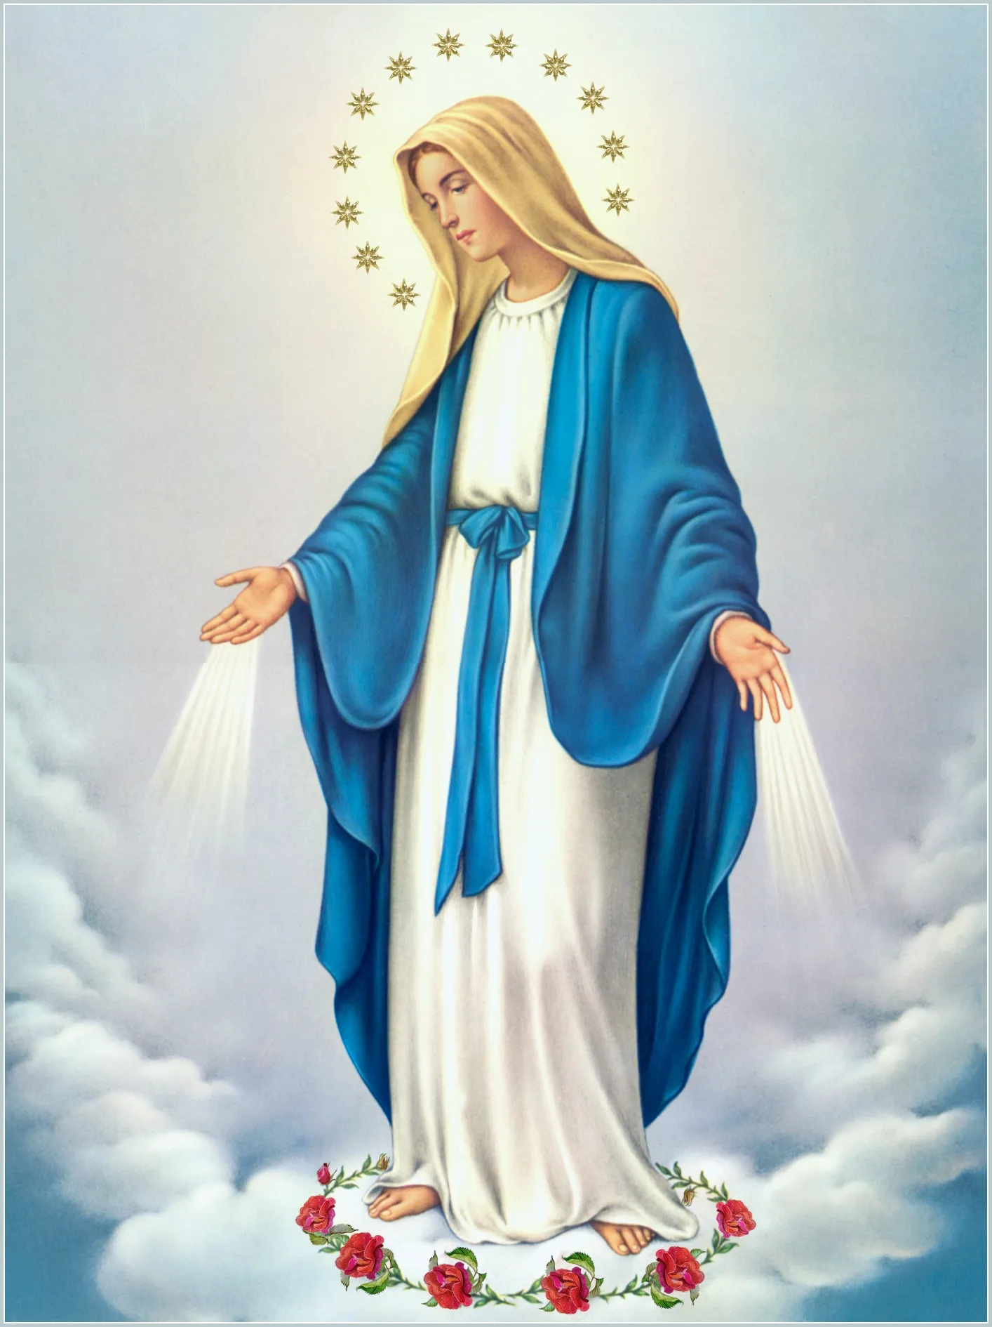
Notes:
Virgin Mary

Slide 10
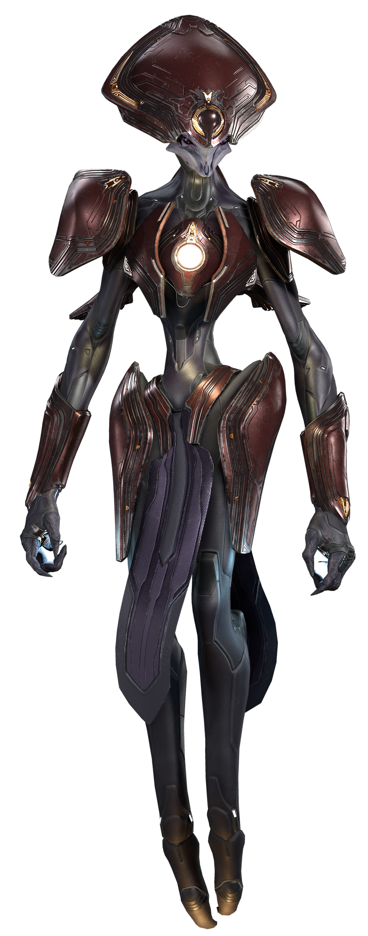
Notes:
Harbinger

Slide 11
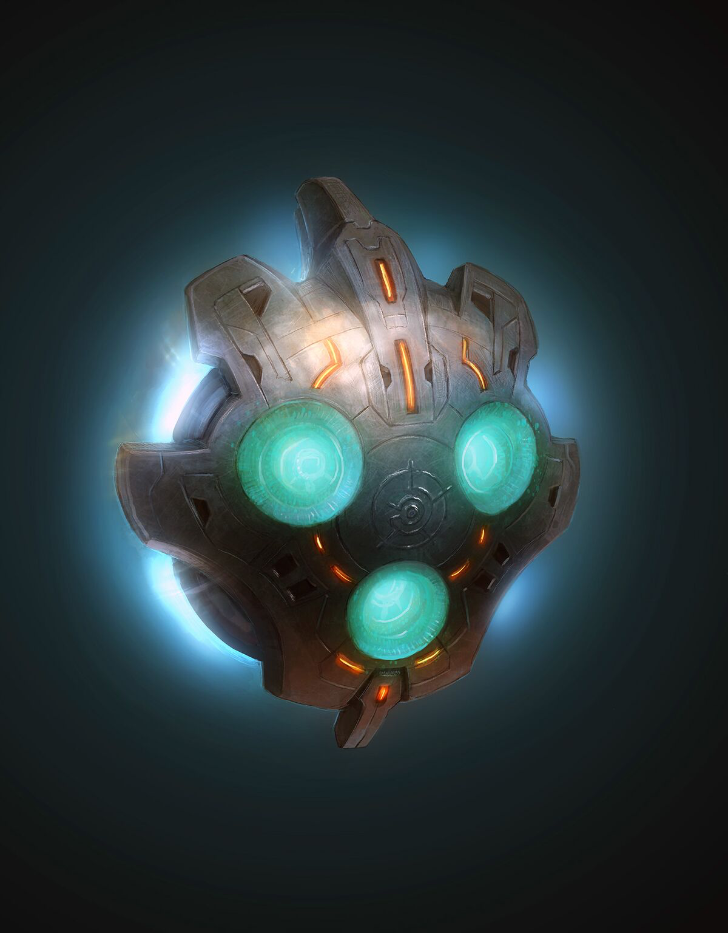
Notes:
05-032 Mendicant Bias

Slide 12
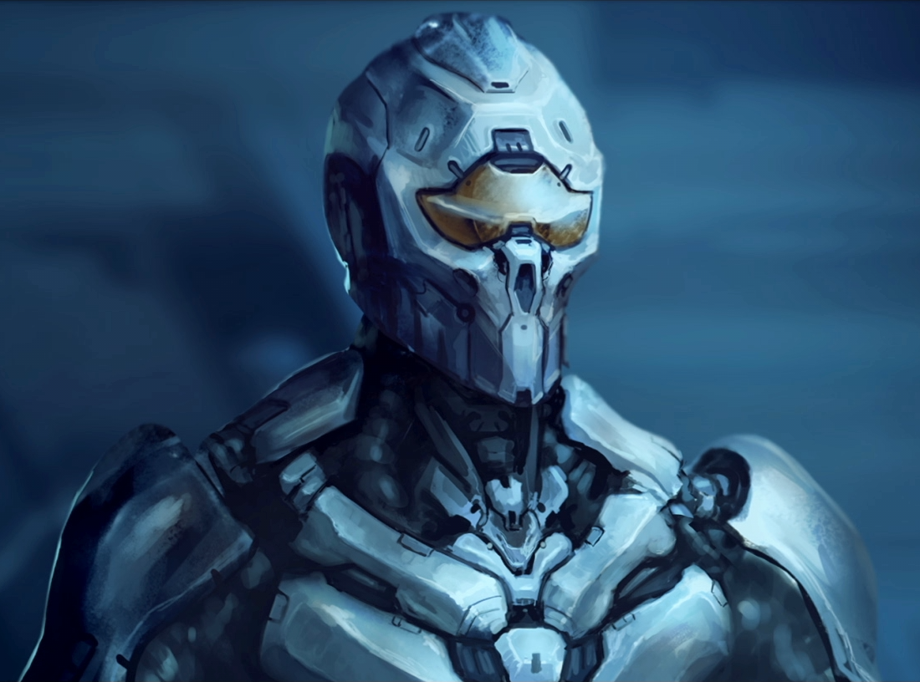
Notes:
Didact (Shadow-of-Sundered-Star)

Slide 13
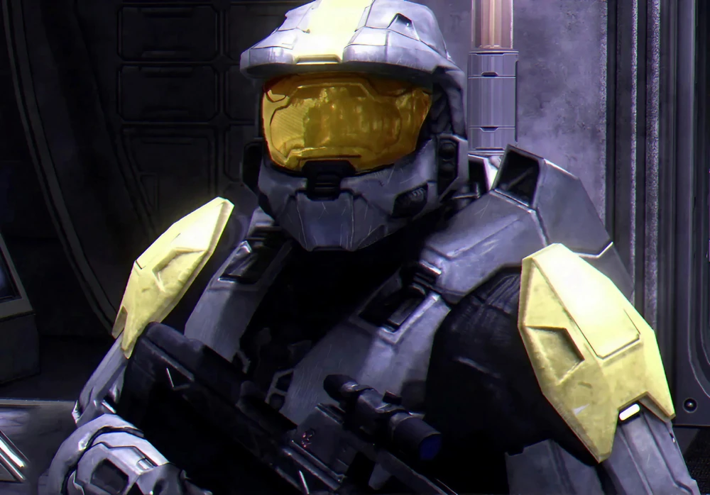
Notes:
Washington

Slide 14
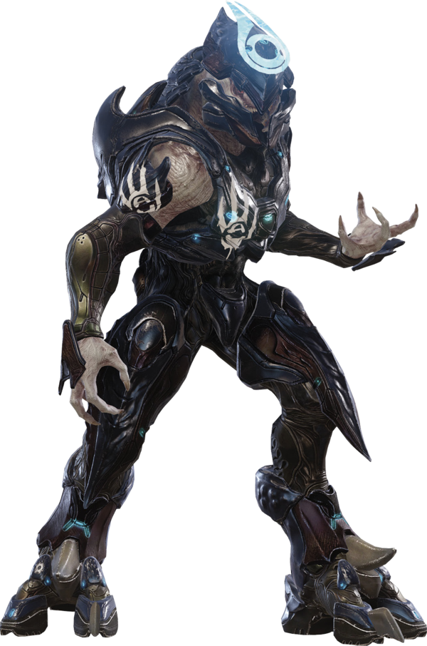
Notes:
Jul ‘Mdama

Slide 15
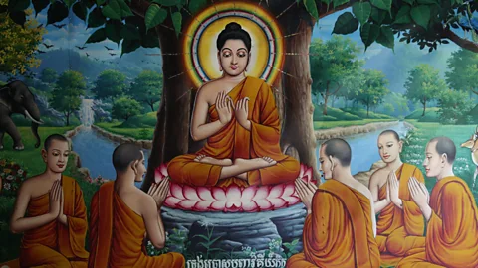
Notes:
Buddha

Slide 16
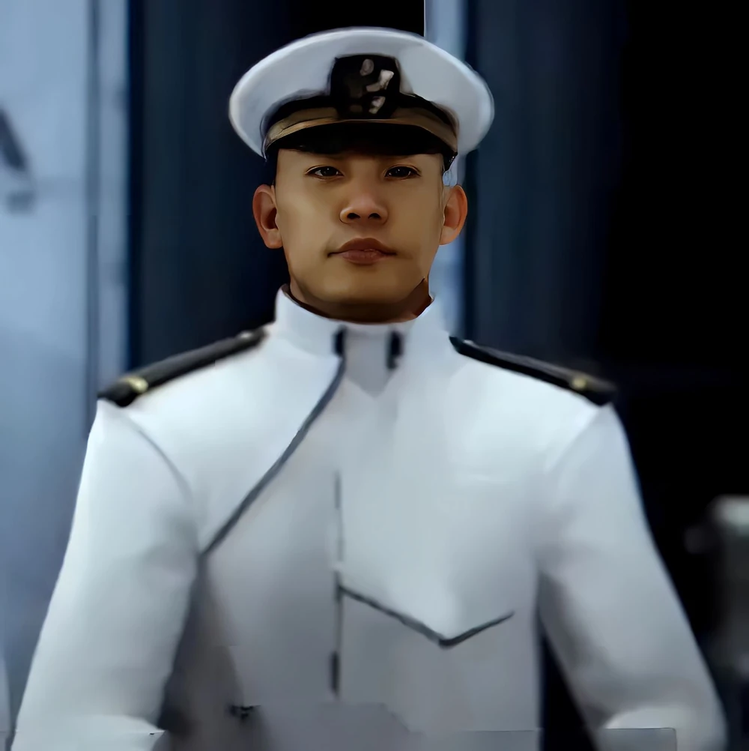
Notes:
Andy Wong

Slide 17
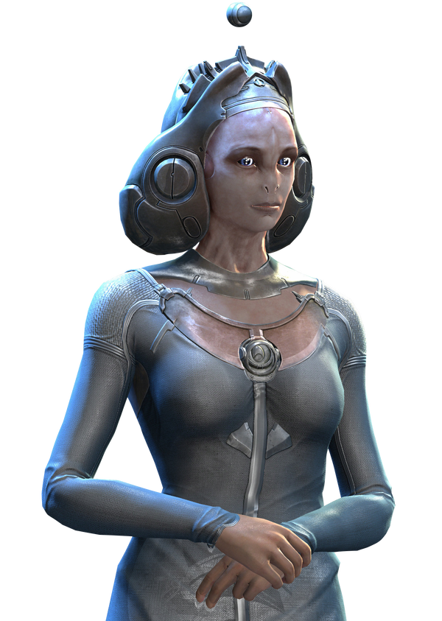
Notes:
Librarian

Slide 18
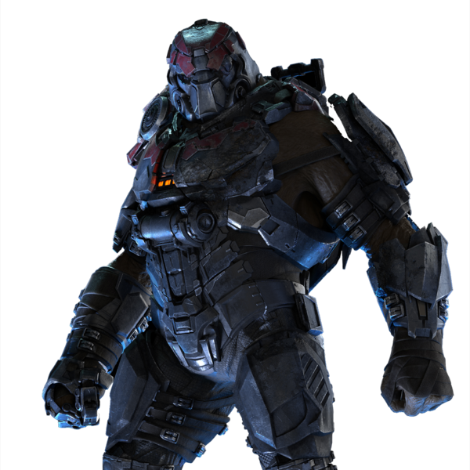
Notes:
Voridus

Slide 19
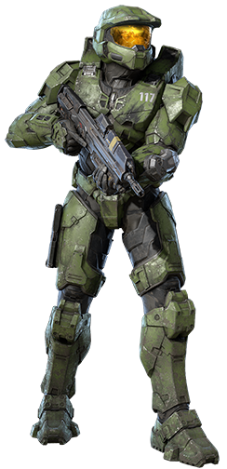
Notes:
Masterchief

Slide 20
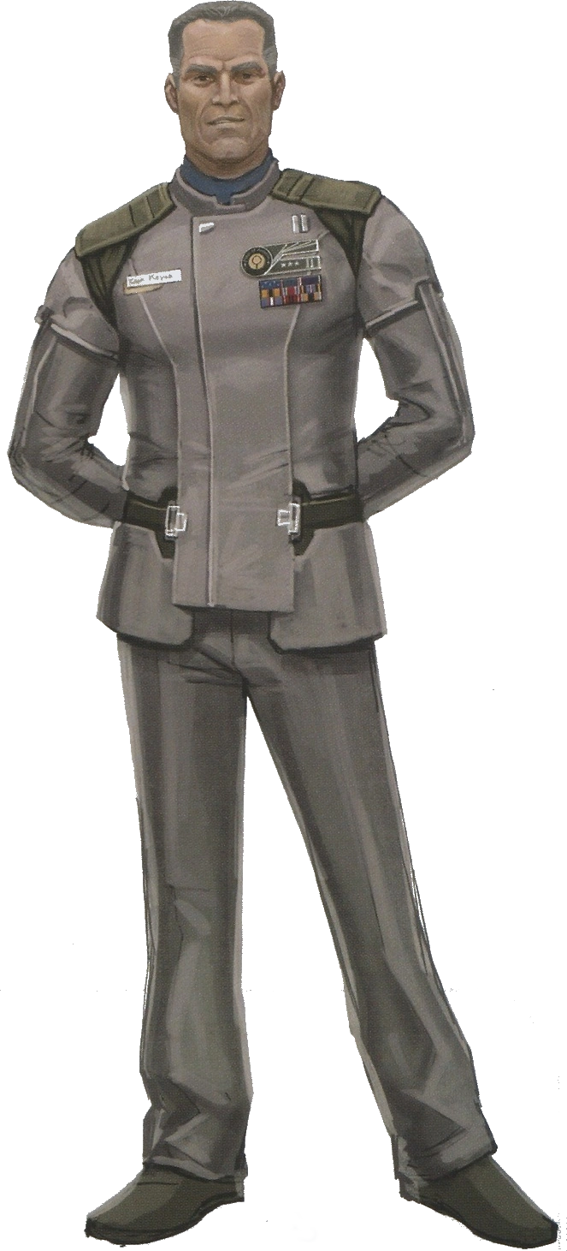
Notes:
Jacob Keyes

Slide 21
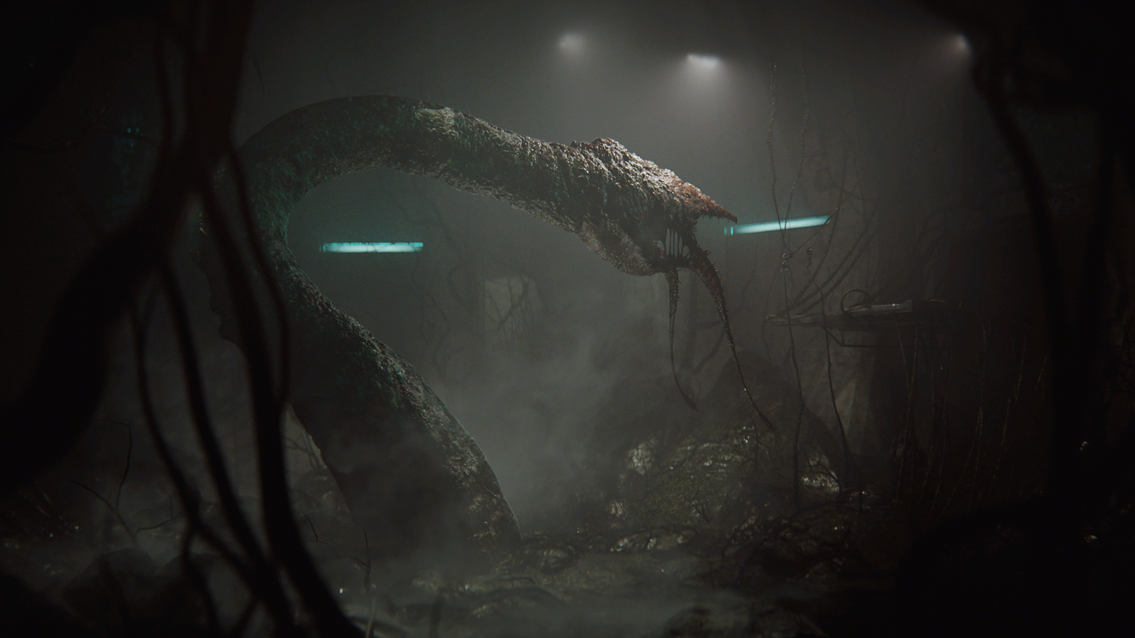
Notes:
Gravemind

Slide 22
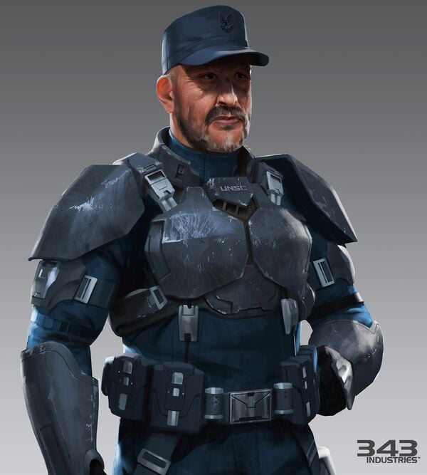
Notes:
Franklin Mendez

Slide 23
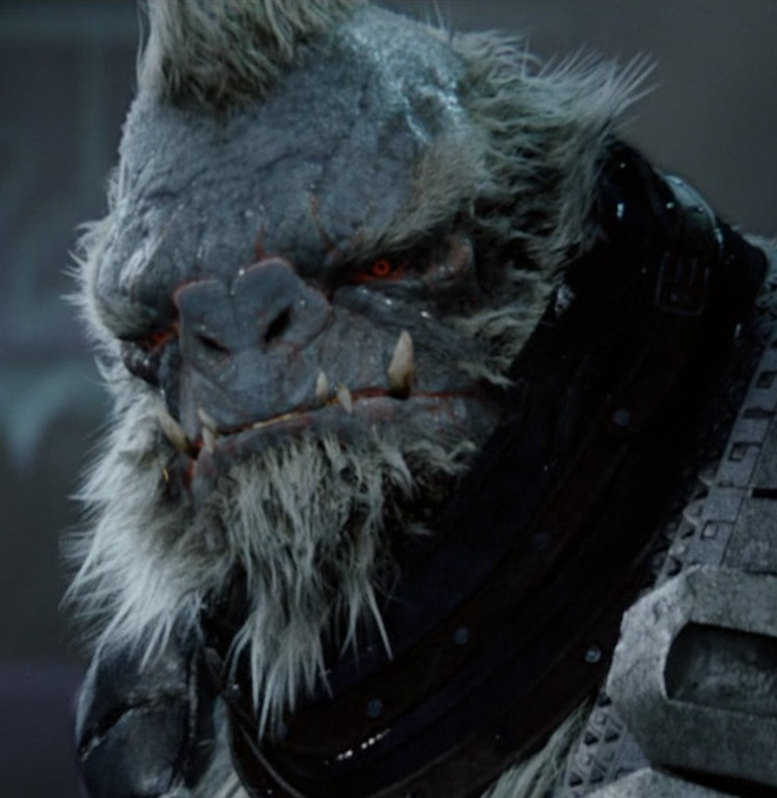
Notes:
Tartarus

Slide 24
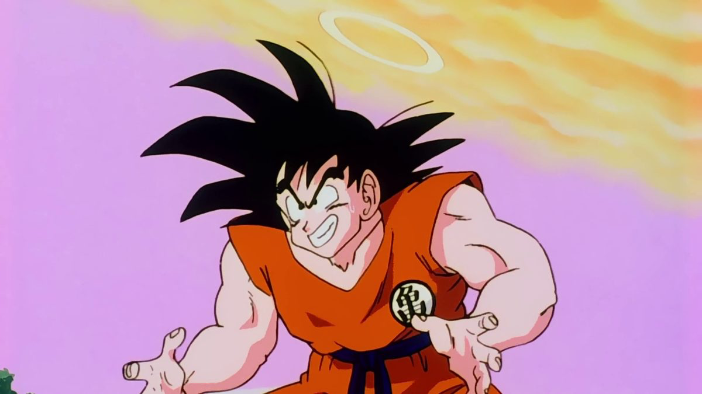
Notes:
goku

Slide 25
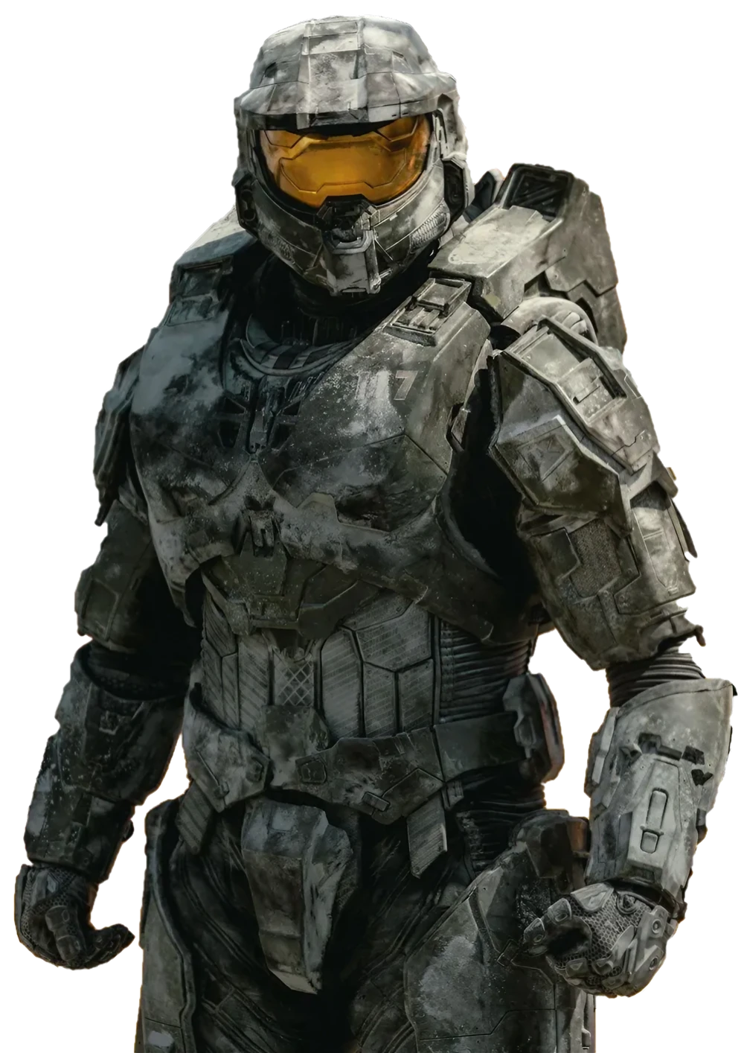
Notes:
Graham Cassidy

Slide 26
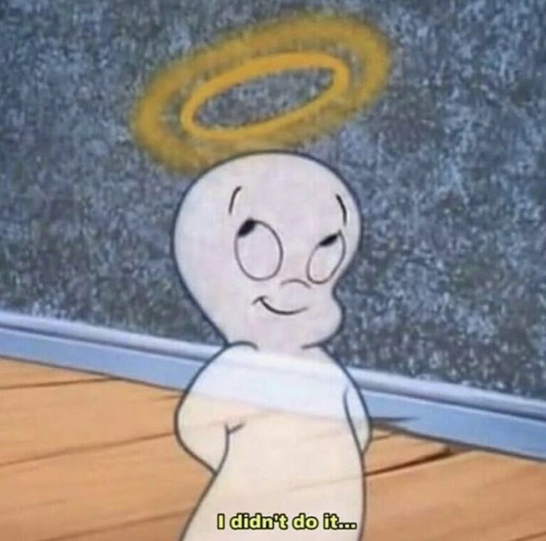
Notes:
Casper the friendly ghost

Slide 27
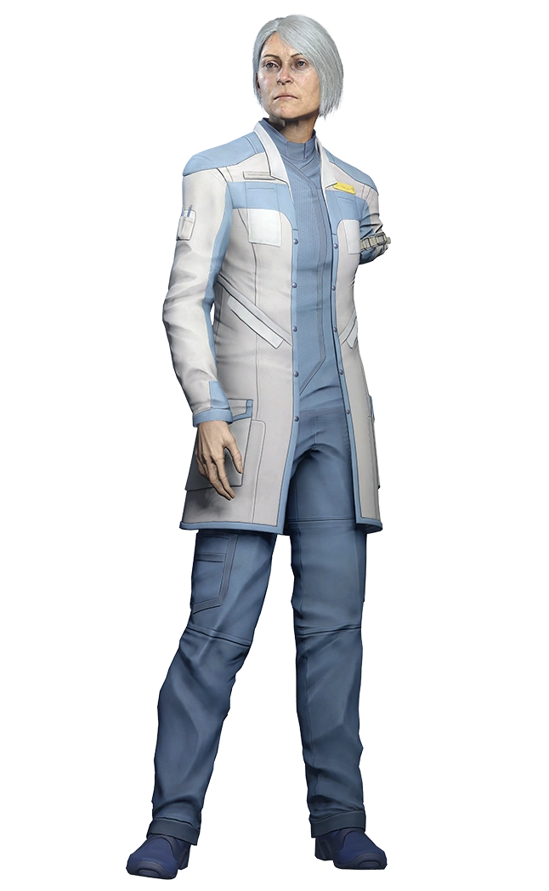
Notes:
Catherine halsey

Slide 28
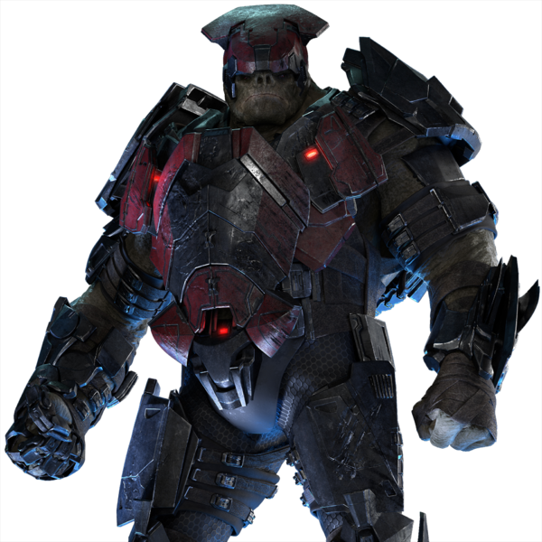
Notes:
Pavium

Slide 29
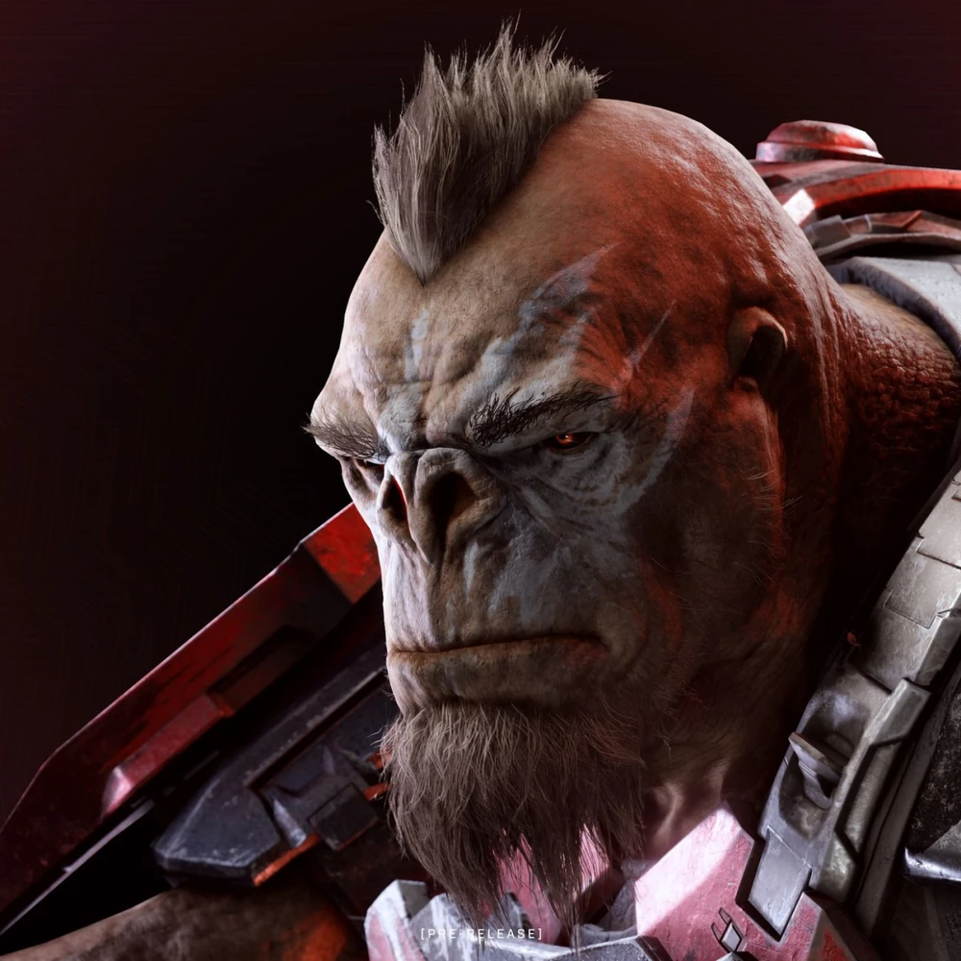
Notes:
Craig

Slide 30
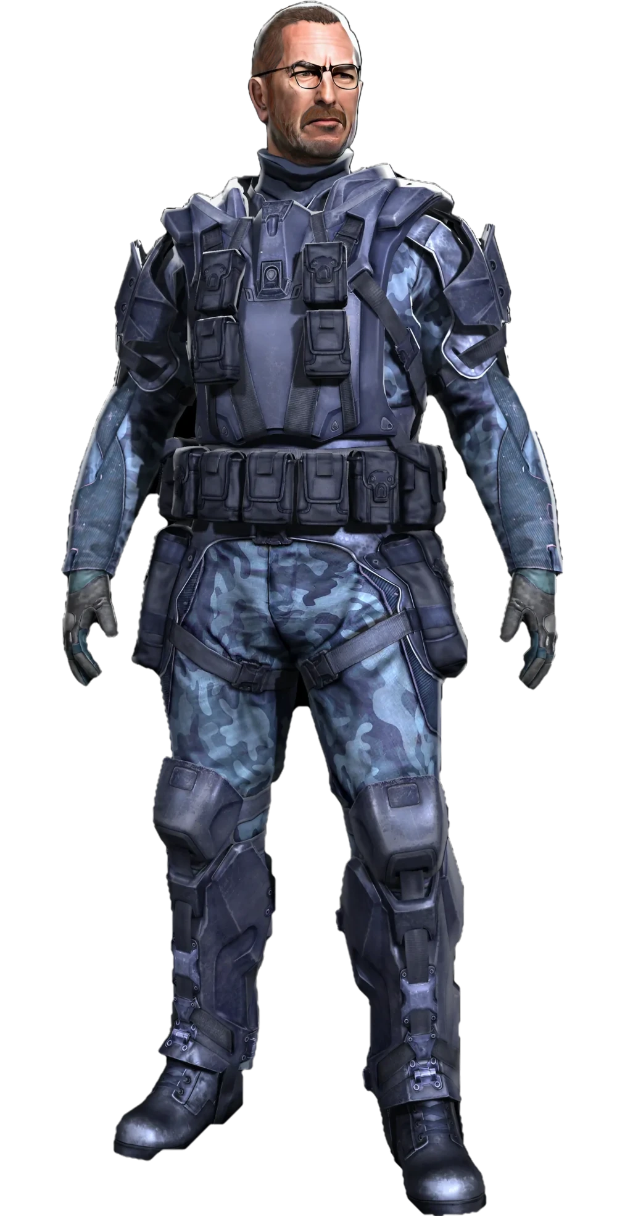
Notes:
Jerry Goodman

Slide 31
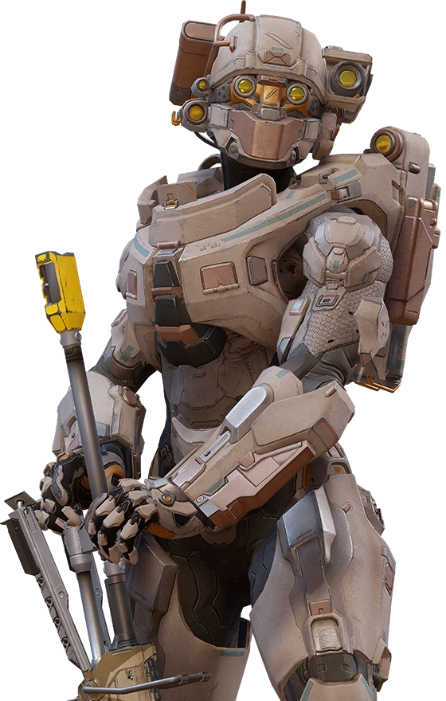
Notes:
linda

Slide 32
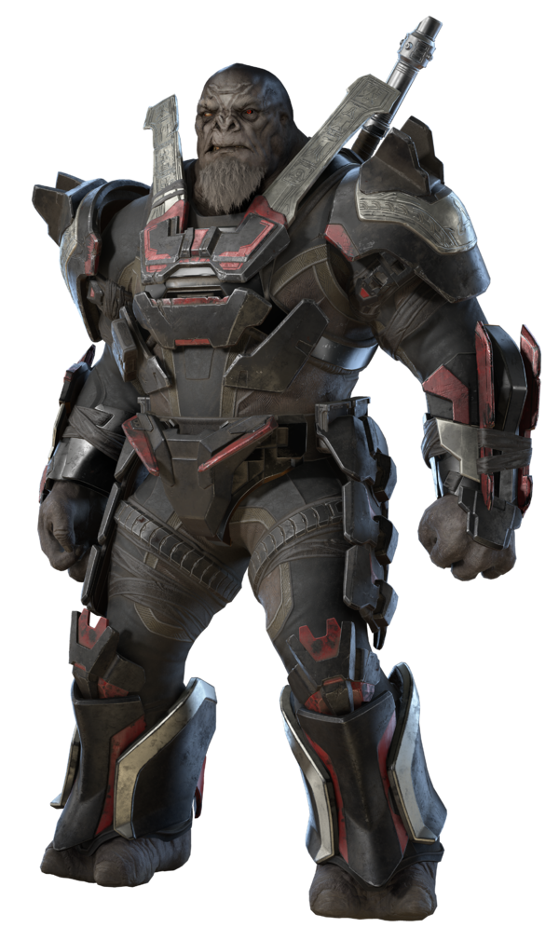
Notes:
Escharum

Slide 33
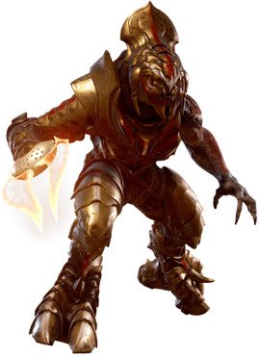
Notes:
Arbiter (Thel ‘Vadam)

Slide 34
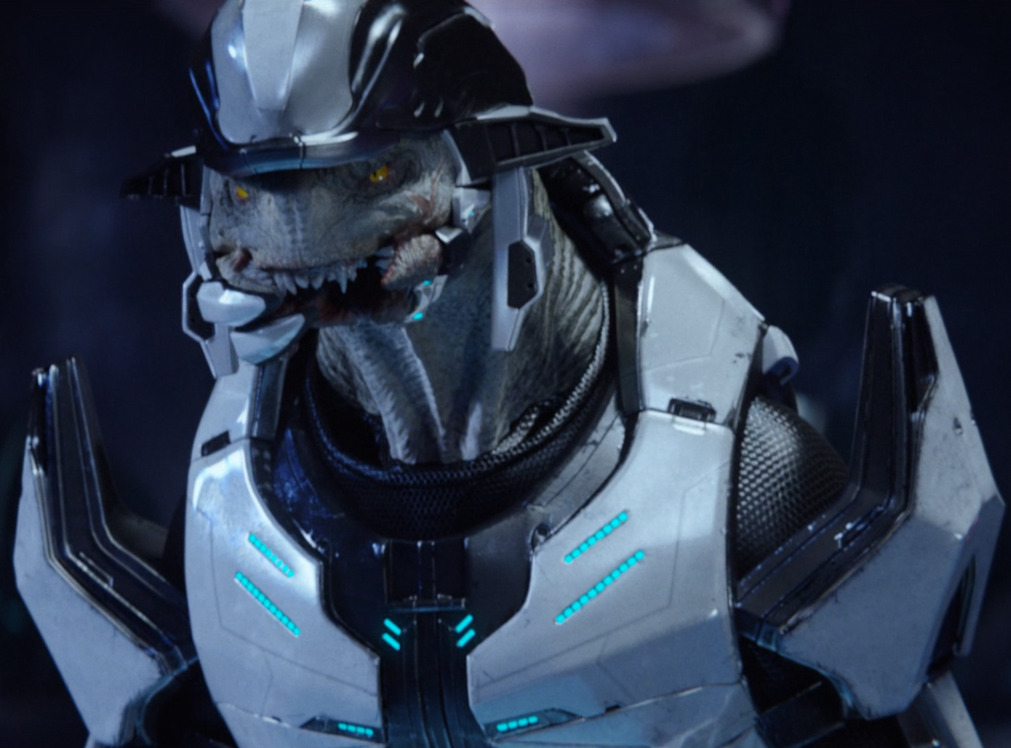
Notes:
Rtas ‘Vadum - Shipmaster

Slide 35
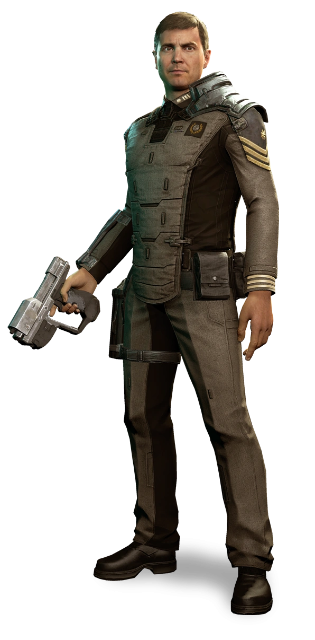
Notes:
Thomas Lasky

Slide 36
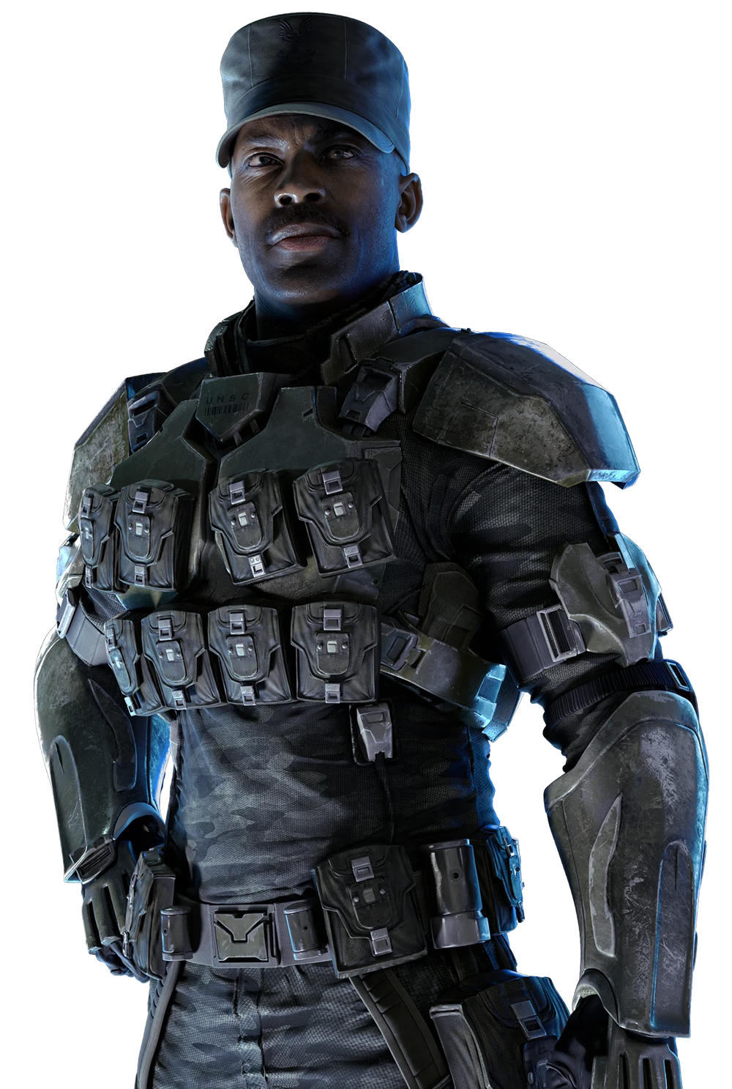
Notes:
Avery Johnson

Slide 37
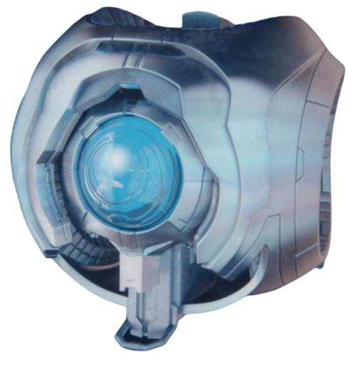
Notes:
343 Guilty Spark

Slide 38
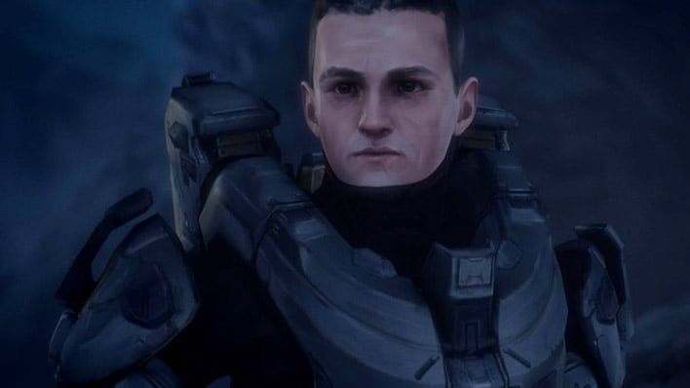
Notes:
Frederic (Fred)-104

Slide 39
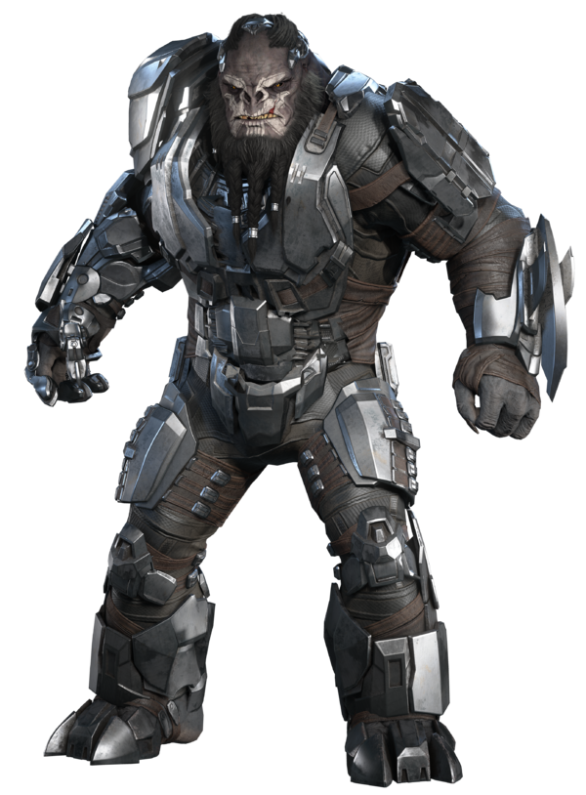
Notes:
Atriox

Slide 40
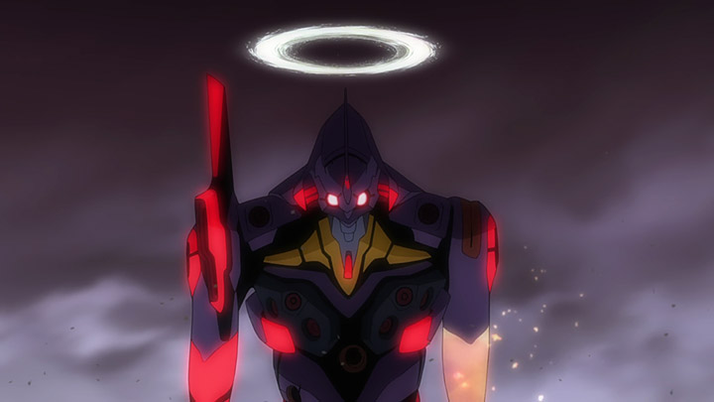
Notes:
Eva-01

Slide 41
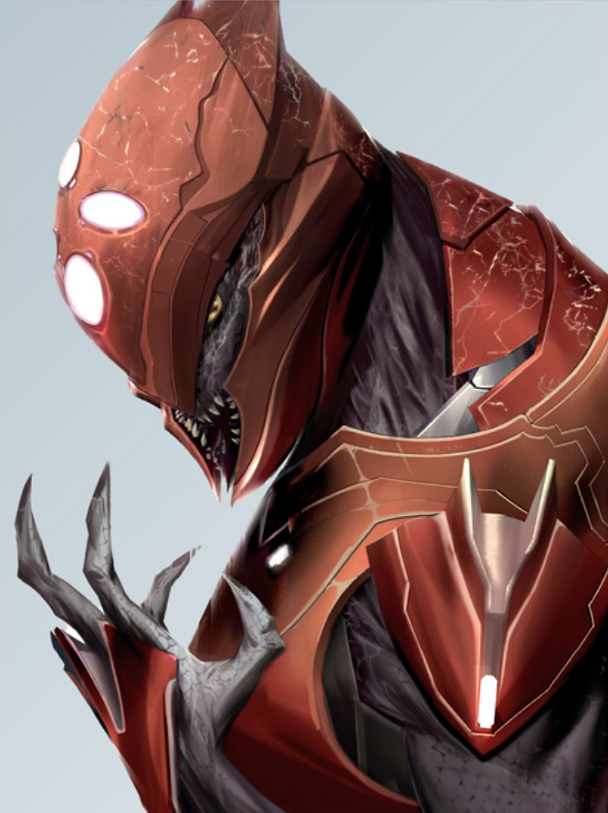
Notes:
Sali Nyon

Slide 42
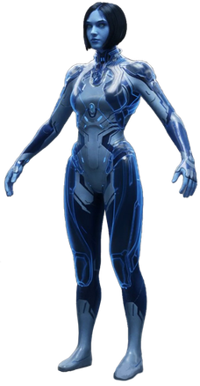
Notes:
Cortana

Slide 43
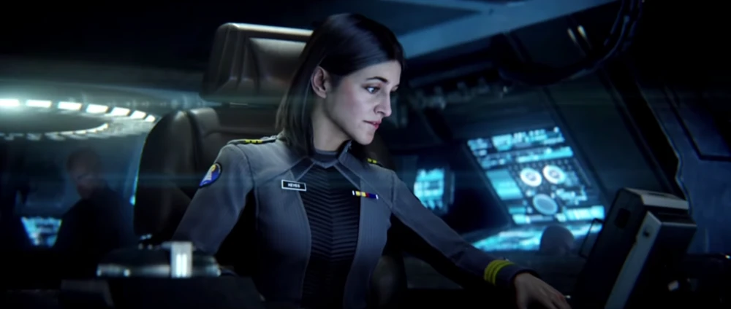
Notes:
Miranda Keyes

